Slide 1
SUBMITTED BY:
AJAY MAHARJAN (HCE075BCT006)
ASHISH RAI (HCE075BCT042)
NIBENDRA BAJRACHARYA (HCE075BCT015)
SUJAN MAHARJAN (HCE075BCT037)
A FINAL YEAR MAJOR PROJECT
ON
IMAGE INPAINTING USING GENERATIVE ADVERSARIAL NETWORKS (GAN)
[CT 707]
SUBMITTED TO:
DEPARTMENT OF ELECTRONICS AND COMPUTER ENGINEERING

Slide 2
Introduction
Image Inpainting underlie Image Processing using deep learning technique.
Improve the quality of an images
Recover the lost fragment or remove the object completely.

Slide 3
Problem Statement
Difficult to restore or recover corrupt image.
Requires photoshop skills which is a tedious process.

Slide 4
Objectives
To implement Generative and Adversarial Network more focused on Pix2Pix.
To develop web-app for restoring old or corrupted photographs.

Slide 5
Scope and Applications
To reconstitute the missing or damaged portions of the work.
To edit an image i.e object removal.

Slide 6
Requirement Analysis
Functional Requirements:
Login/Register
Upload images
Image restoration
Download image

Slide 7
Non-Functional Requirements:
Reliable
Availability
Performance
Scalability
Maintainability
Security

Slide 8
Feasibility Study
Technical Feasibility - Hardware and software tools are within accessible boundaries.
Operational Feasibility - Simple and interactive interface and data drive.
Economic Feasibility - Only a computer is required to access the web application

Slide 9
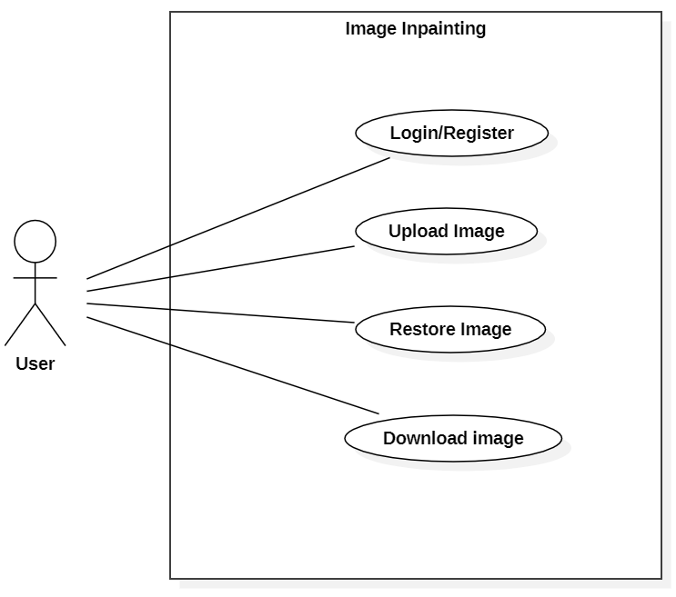
System Design
Use Case Diagram

Slide 10
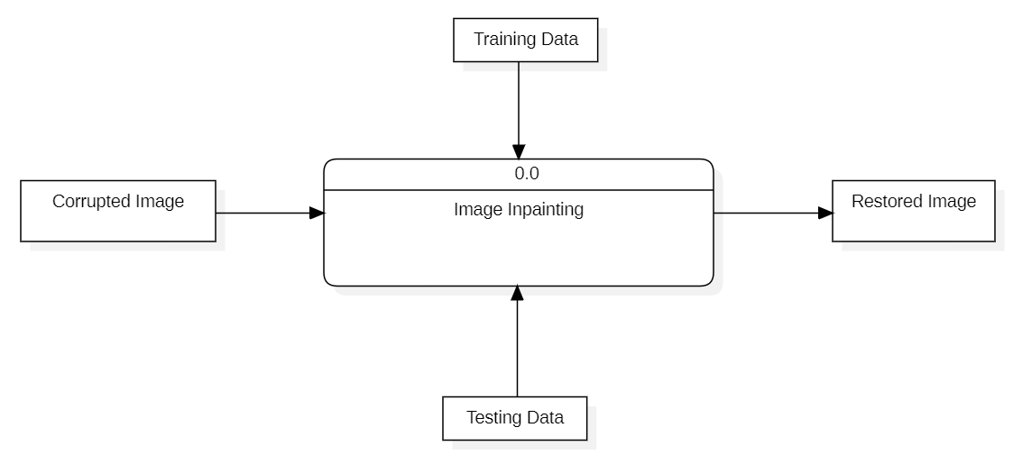
Data Flow Diagram Level 0

Slide 11
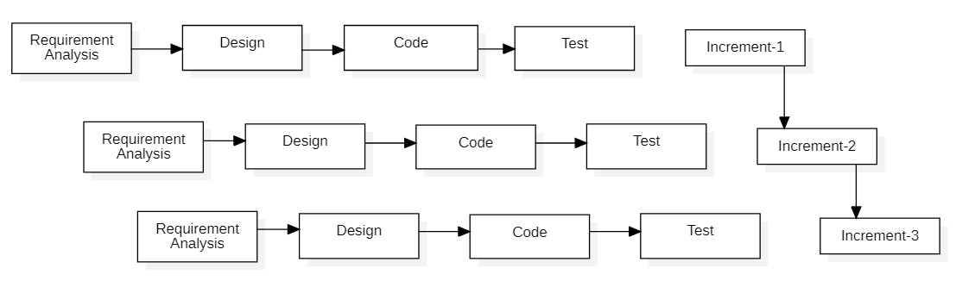
Methodology
Fig : Block diagram of incremental model

Slide 12
Image Inpainting
The main objective is to implement the Deep Conditional GAN on image inpainting.
GAN incorporates two neural networks:
A generator – it takes in the incomplete image as the input and generates a fake full image with the missing segment filled.
A discriminator – it tries to distinguish generated images from original full images.
They will operate on min-max algorithm which have some loss function.

Slide 13
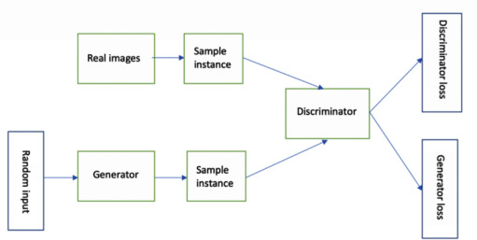

Slide 14
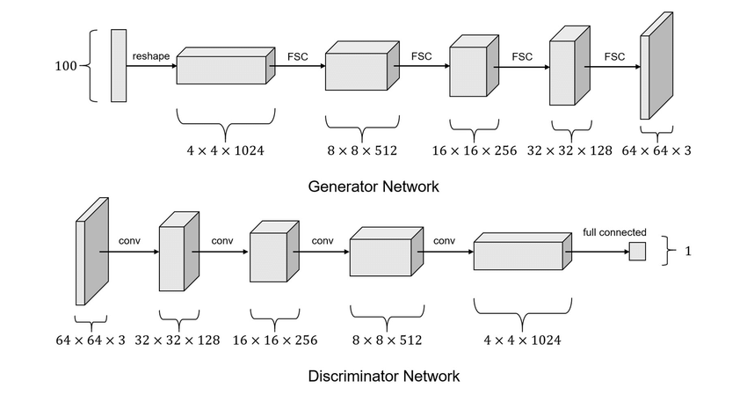
Network Architecture

Slide 15
The network architecture of the generator is based on U-Net.
The generator consists of the convolutional layers in encoder-decoder fashion, that generates the recovered images from cropped images.
Encoder, a shrinking network that shrinks the tensor layer by layer.
Decoder, a expanding network that expands the depth of the tensor layer by layer.
The final output of the generator is the recovered image from the cropped image, which is of the original size.
The recovered image of the generator is then injected into the discriminator, that determines whether the image is real or fake.

Slide 16
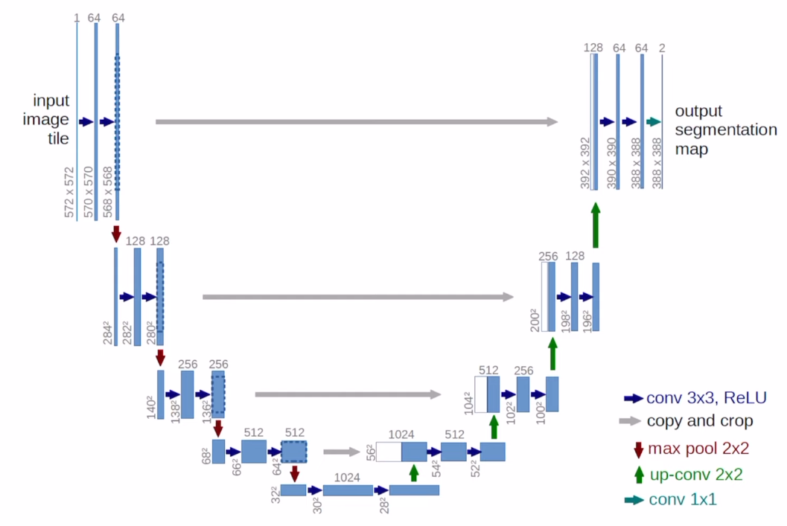

Slide 17
Frontend development:
JavaScript – React
CSS
Backend development:
Node JS
Python

Slide 18
Tasks completed
A homepage showcasing the basic functionality of our application has been created.
Reviewed some research papers on GAN models used for image inpainting.

Slide 19
Tasks remaining
Dynamic properties of a web application need to be added.
GAN model with the corresponding generator and discriminator needs to be built.
Data preprocessing.
Training the model.
Building database, creating APIs.

Slide 20
References
[1] S. Salve, T. Shah, V. Ranjane, and S. Sadhukhan, "Automatization of coloring grayscale images using convolutional neural network," 2018.
[2] V. K. Putri and M. I. Fanany, "Sketch plus colorization deep convolutional neural networks for photos generation from sketches," pp. 1-6, 2017.
[3] H. H. Chen Y, "An improved method for semantic image inpainting with gans: progressive inpainting.," Neural Process Lett, p. 1355–1367, 2019.
[4] Vitoria P, Sintes J, Ballester C, "Semantic image inpainting through improved Wasserstein generative adversarial networks," 2018.
[5] Nazeri K, Ng E, Joseph T, Qureshi F, Ebrahimi M, "Edgeconnect: generative image inpainting with adversarial edge learning," 2019.
[6] Yuan L, Ruan C, Hu H, Chen D, "Image inpainting based on patch-GANs," 2019.

Slide 21
Thank You

